Slide 1
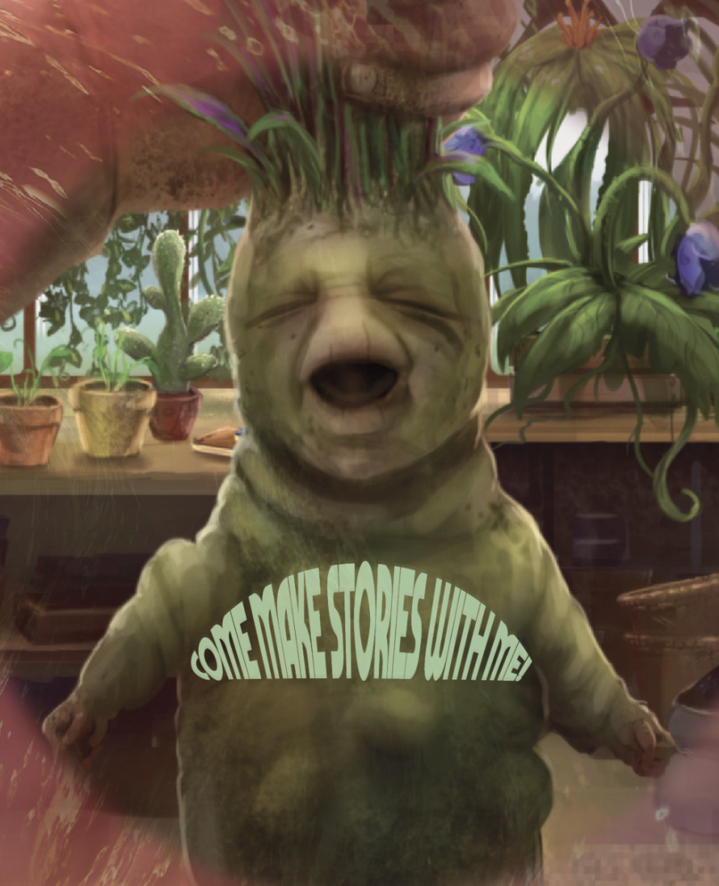
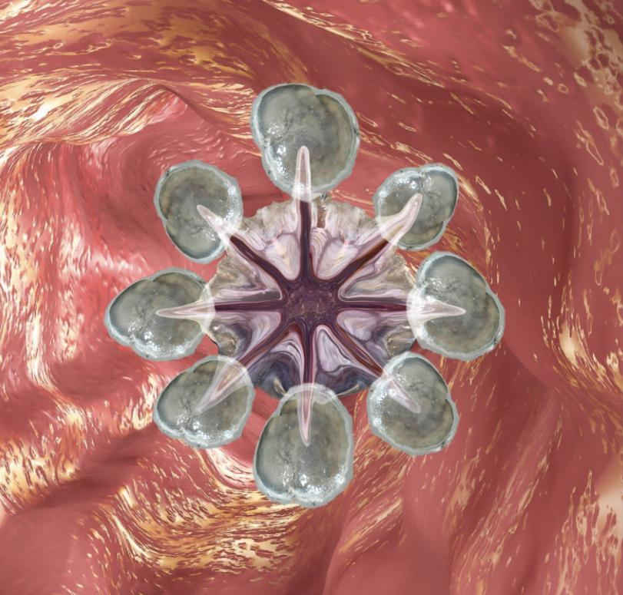
Embodied Storytelling/‘Nature’ Portal

Slide 2
Natureculture
Animism / Perspectivism / Making stories with “nature” in mythology
Exploring how to get into a receptive state / quieting critical mind
Somatic exercises / sensing with the whole body
Creative Writing with nonhumans

Slide 3
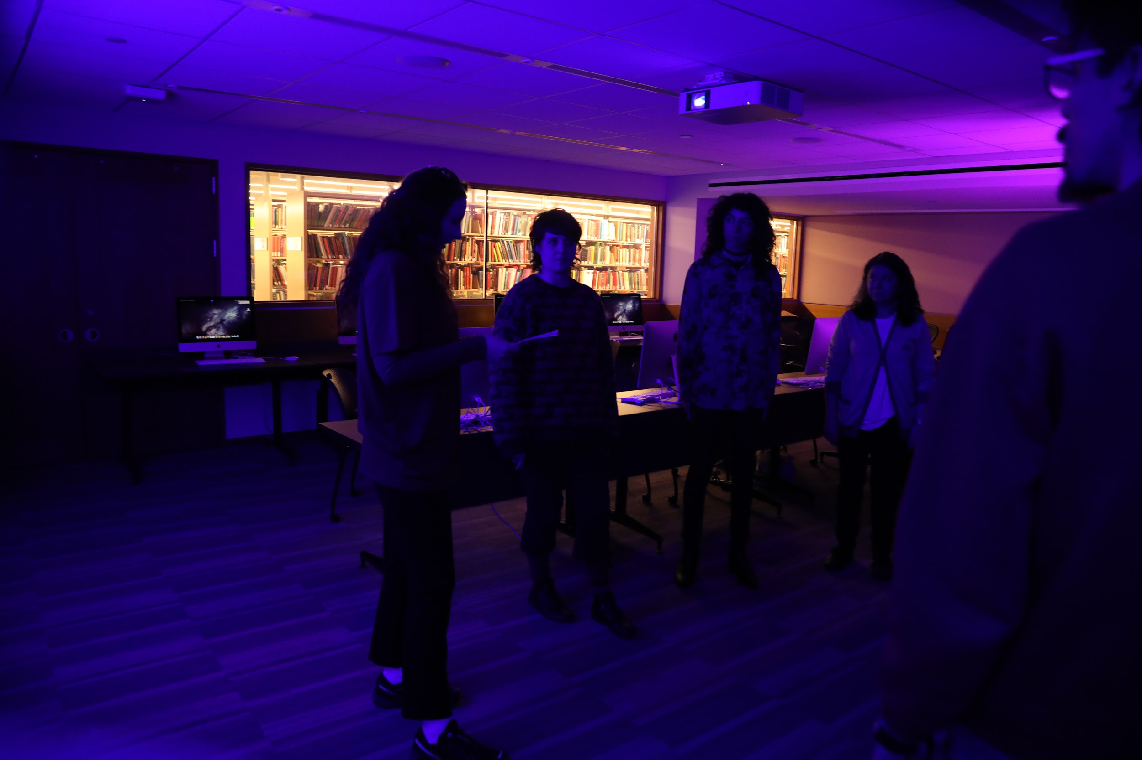
INTRODUCTION
1. Jump into body warm up
exercises
2. Introduce the workshop,
brief concept overview,
some of the format /
schedule
3. Lead Body Humming
4. Go to assigned stations

Slide 4
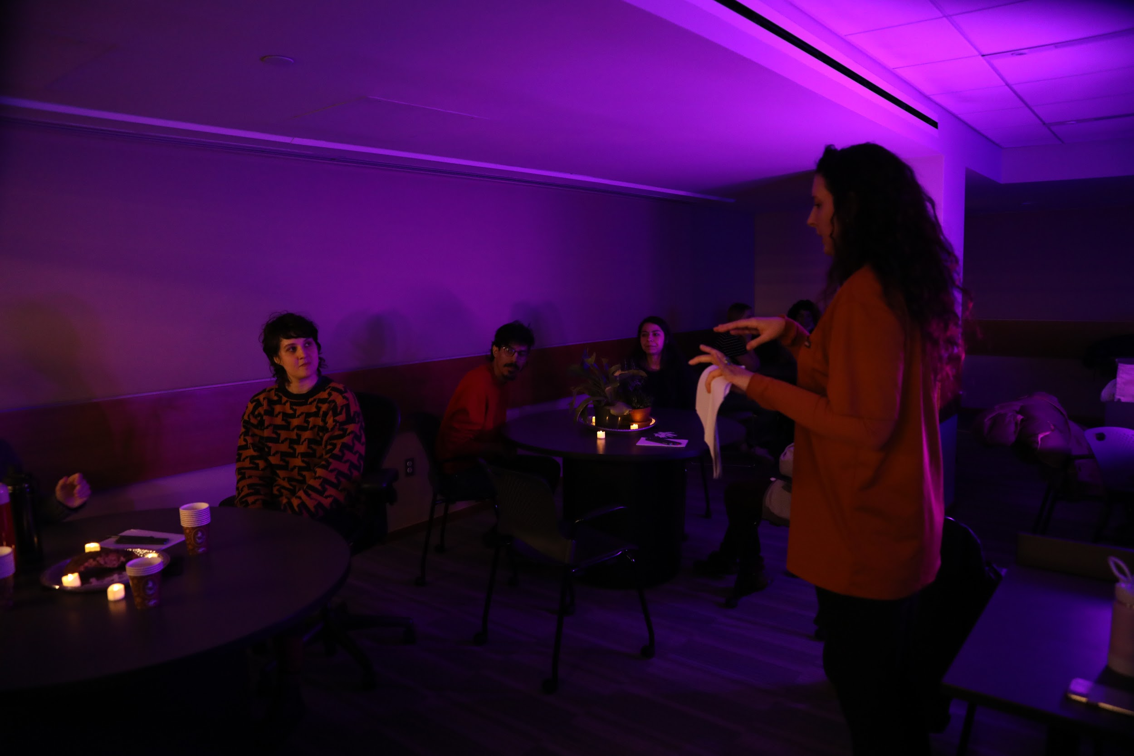
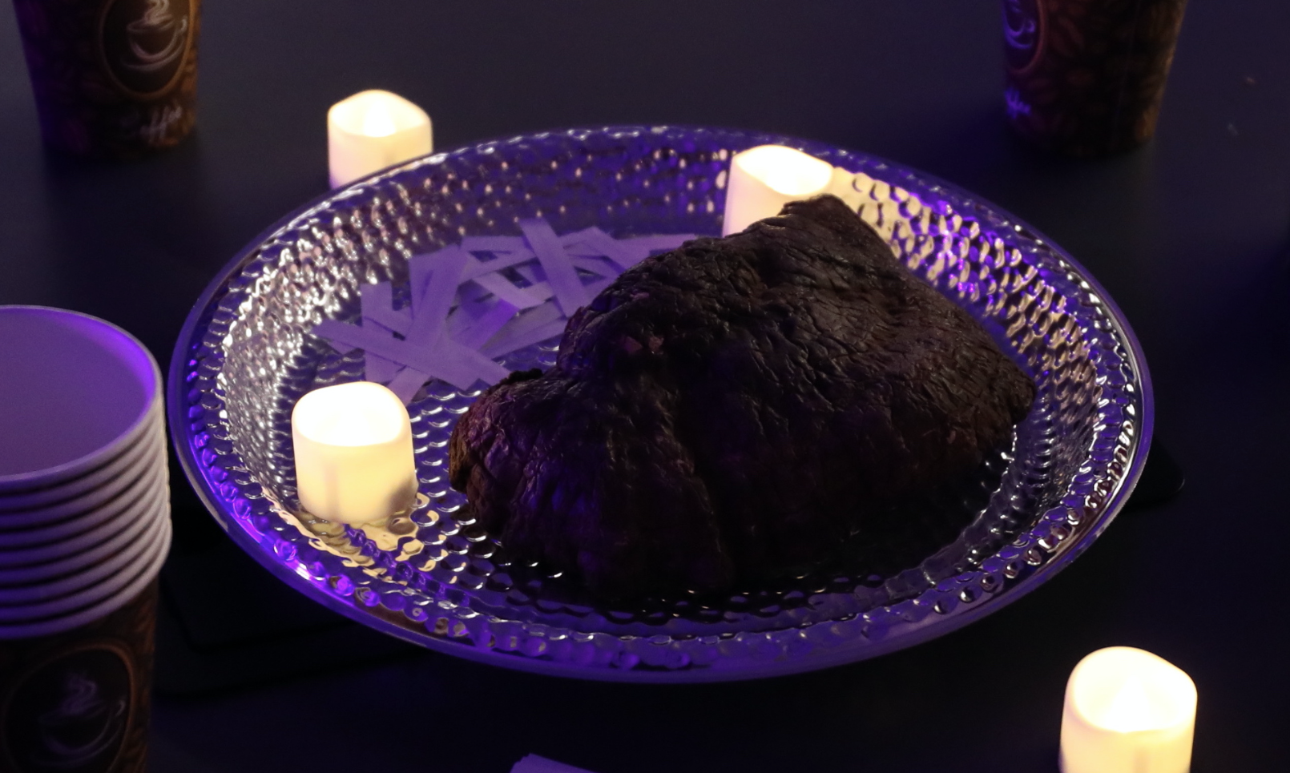
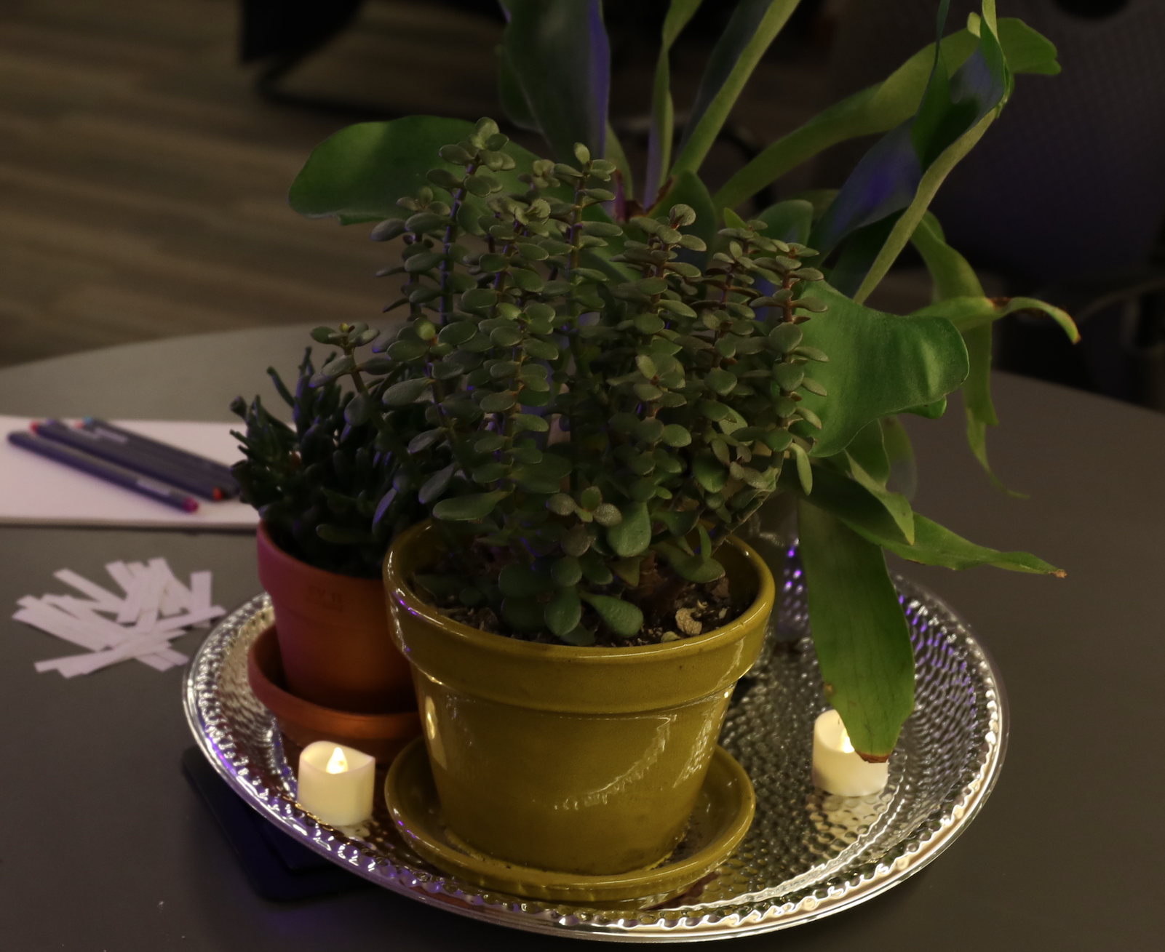
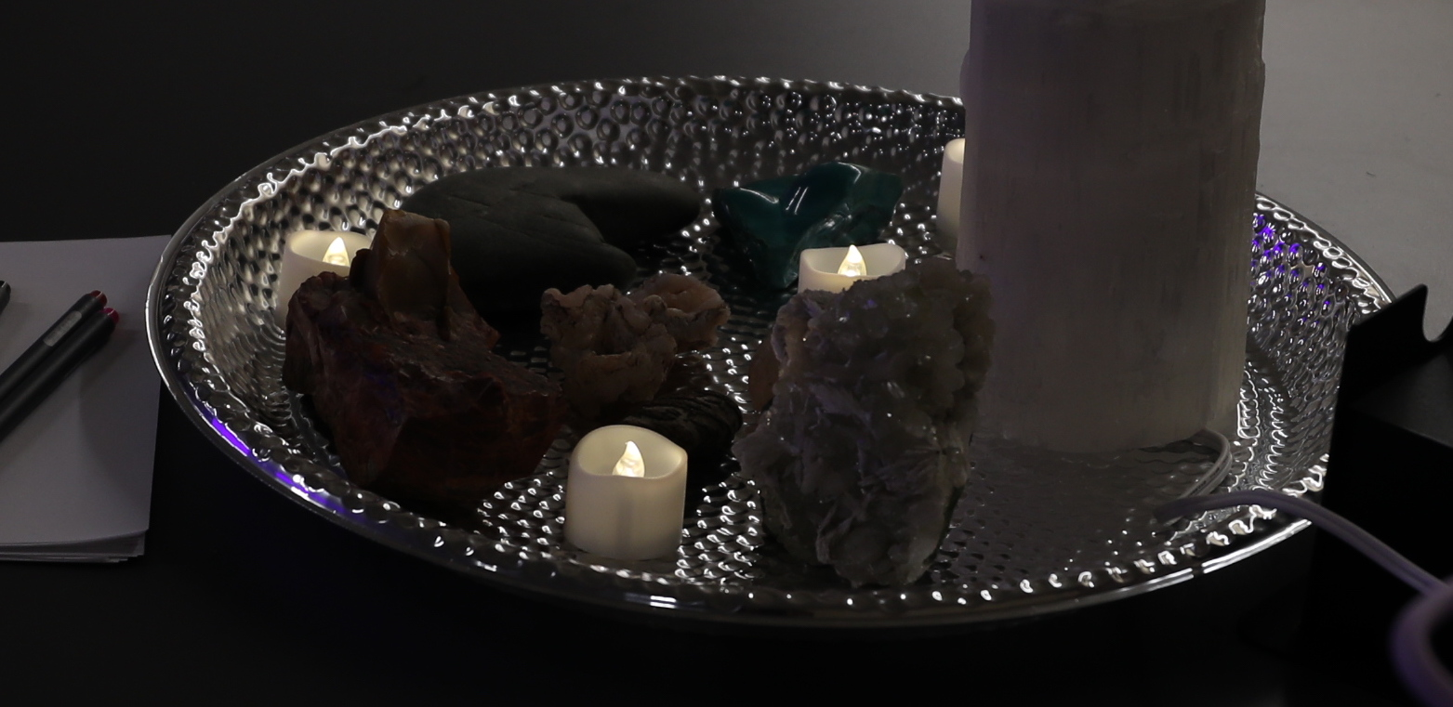
STATIONS - Fungus, Plants & Rocks

Slide 5
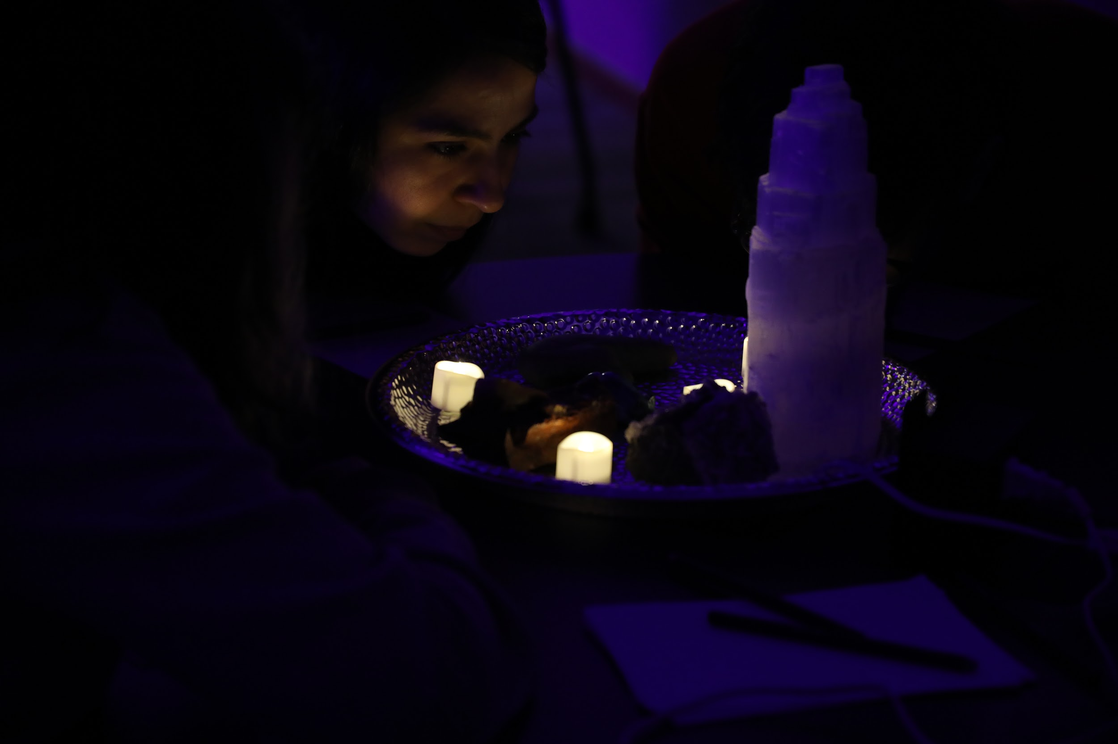
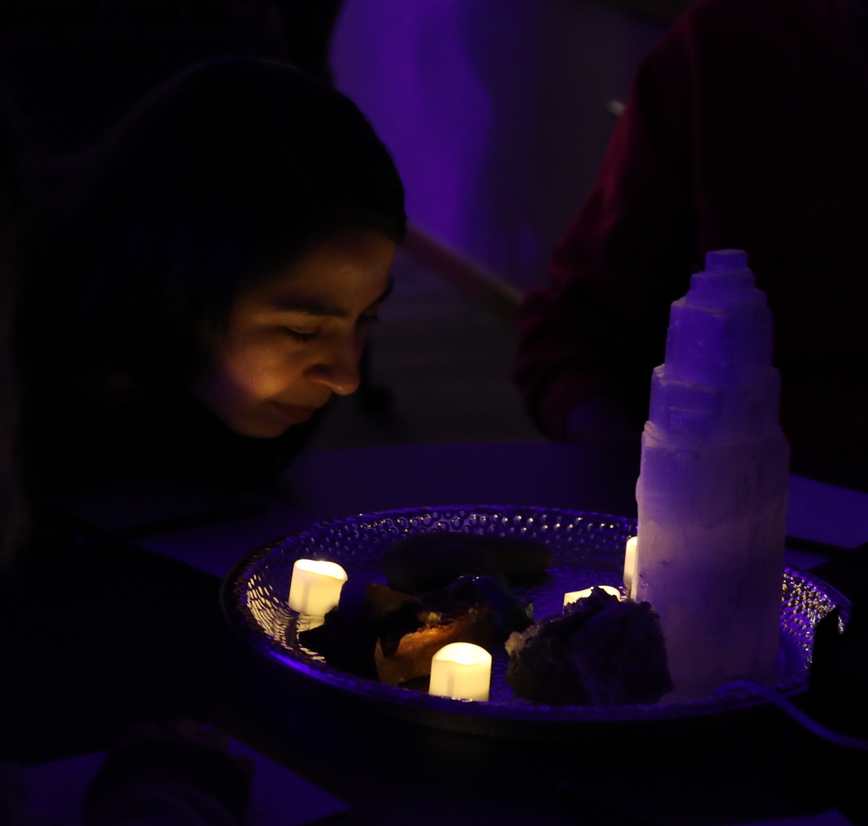
Rock Station

Slide 6
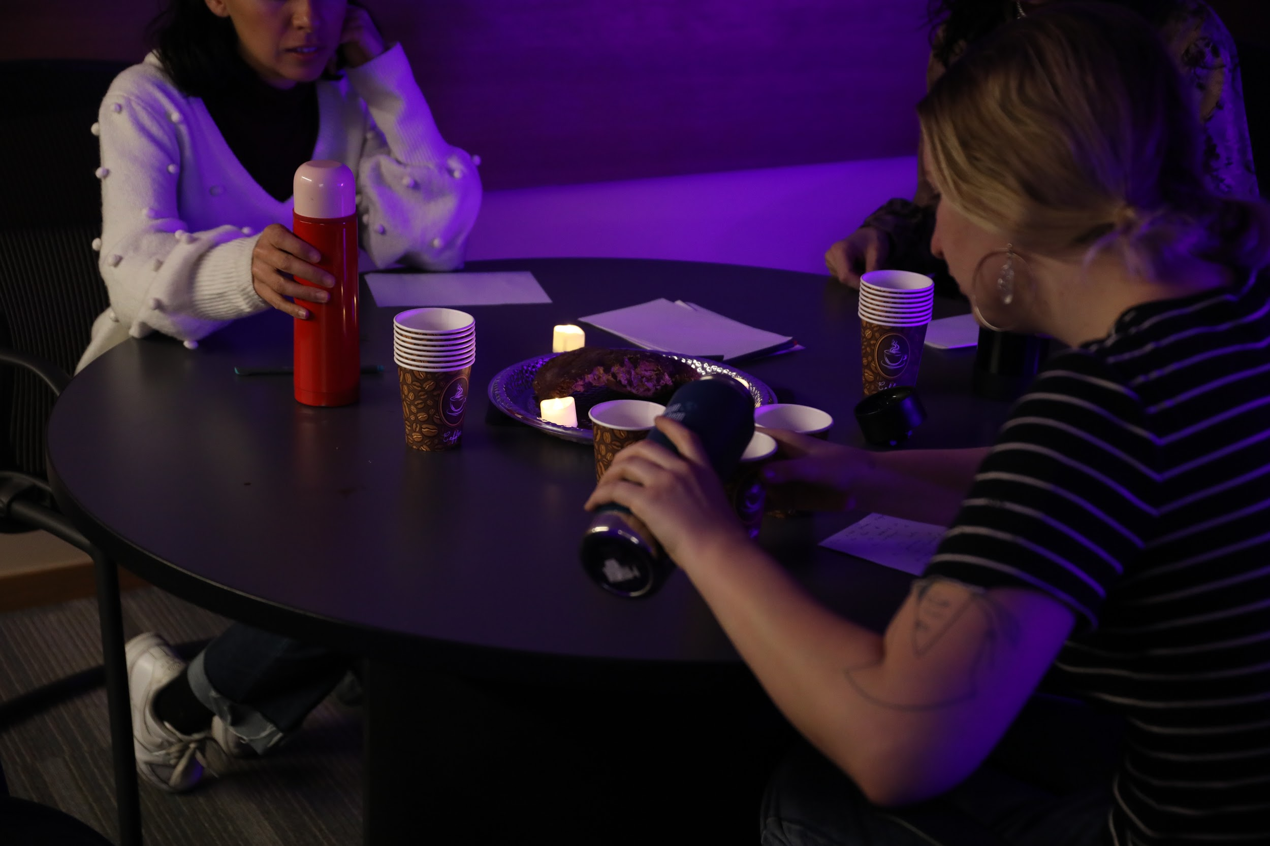
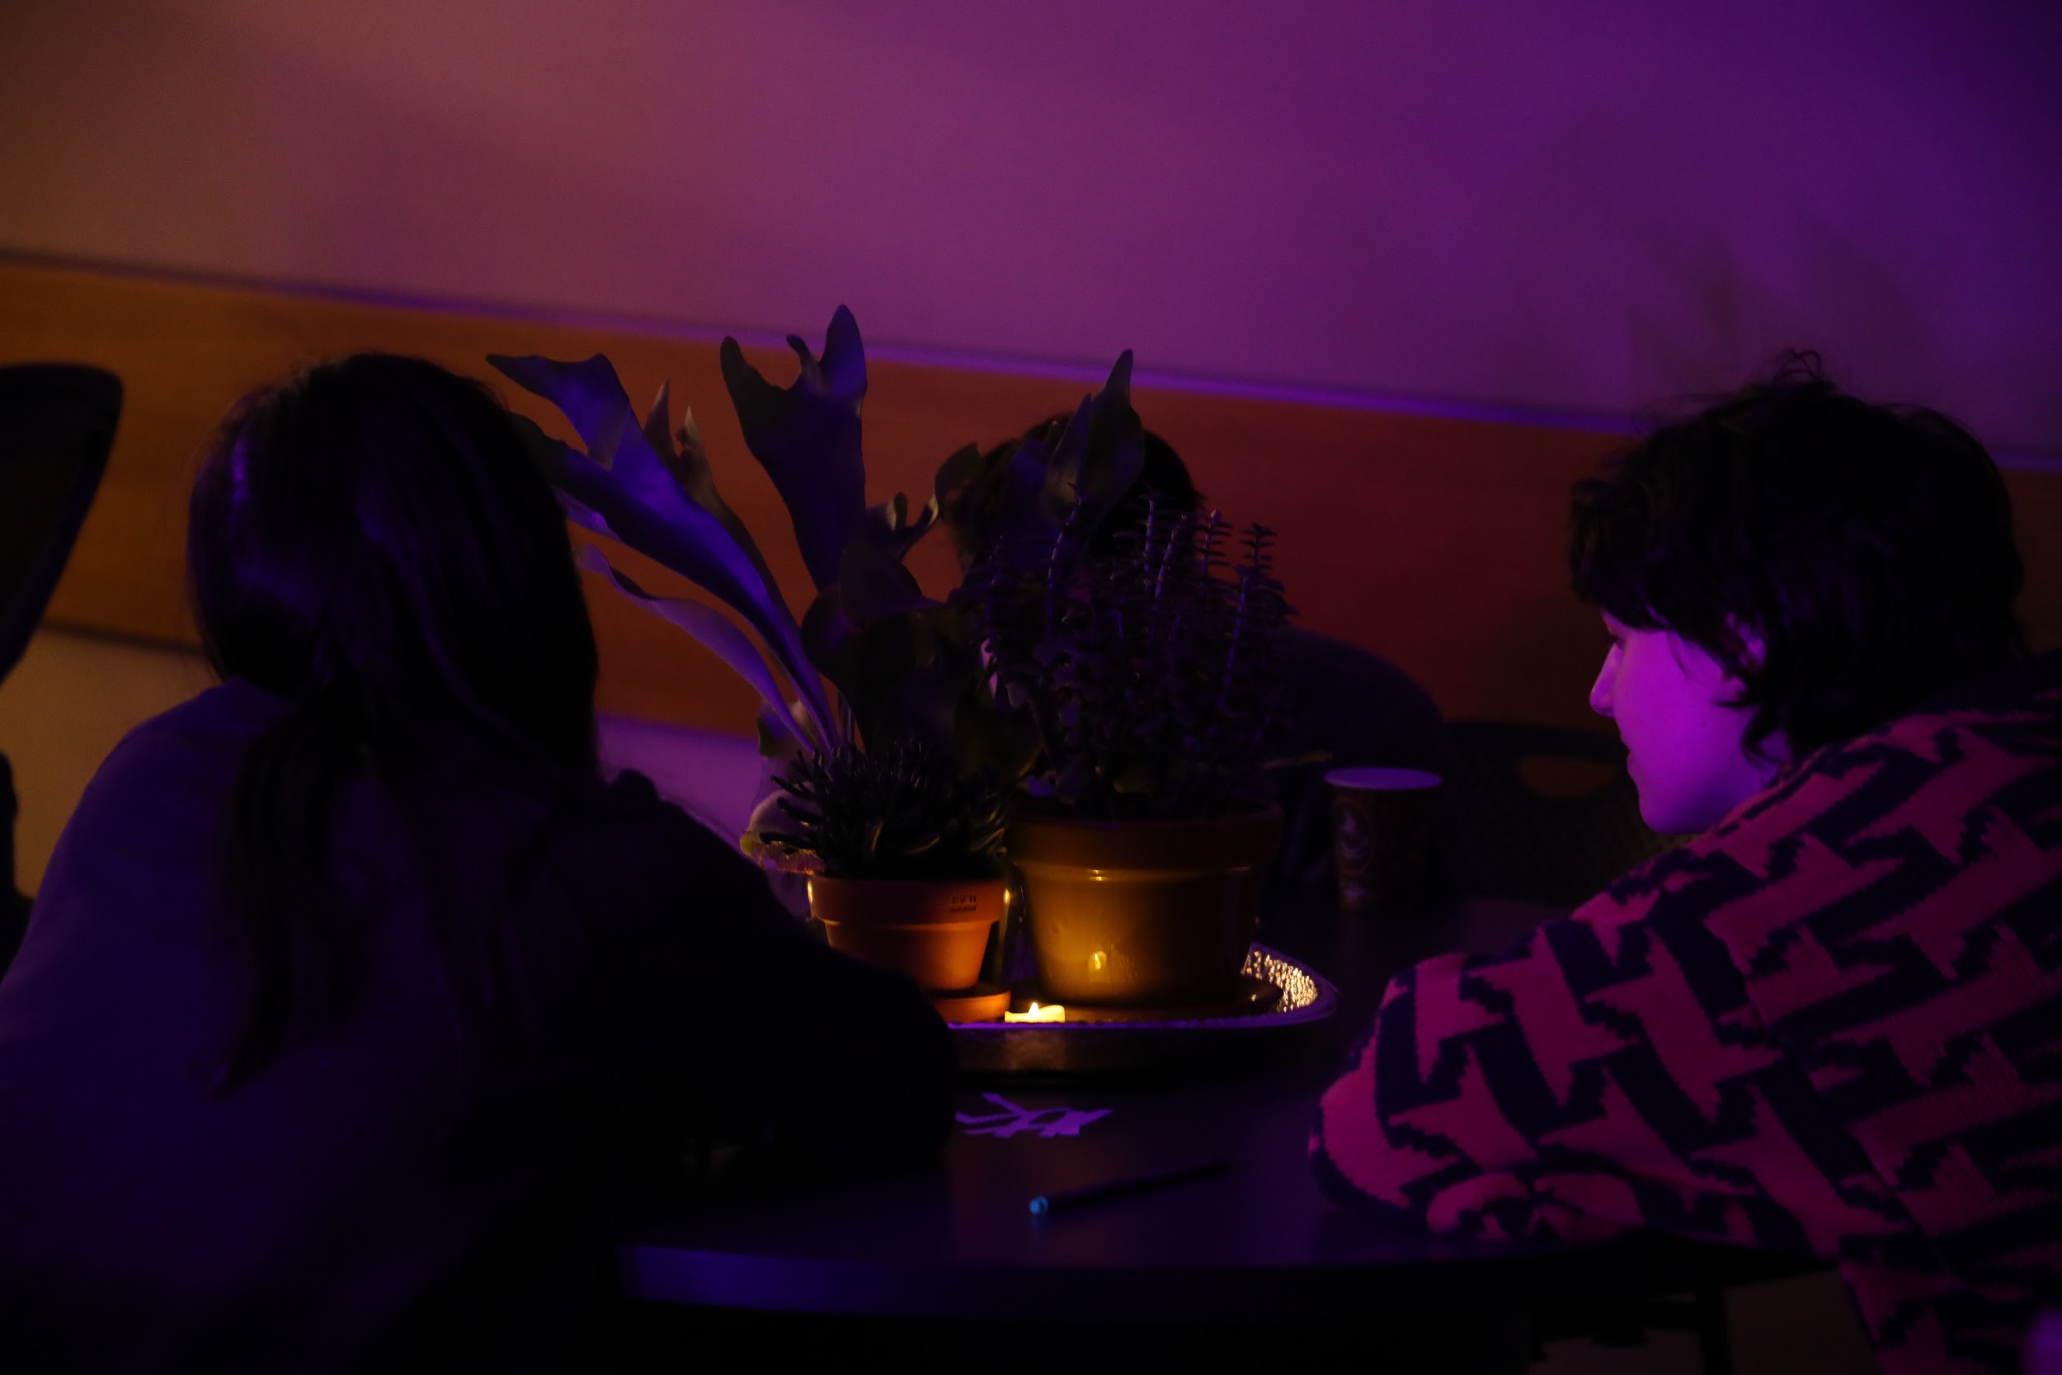
Drinking mushroom tea
Soft 2 way gaze

Slide 7
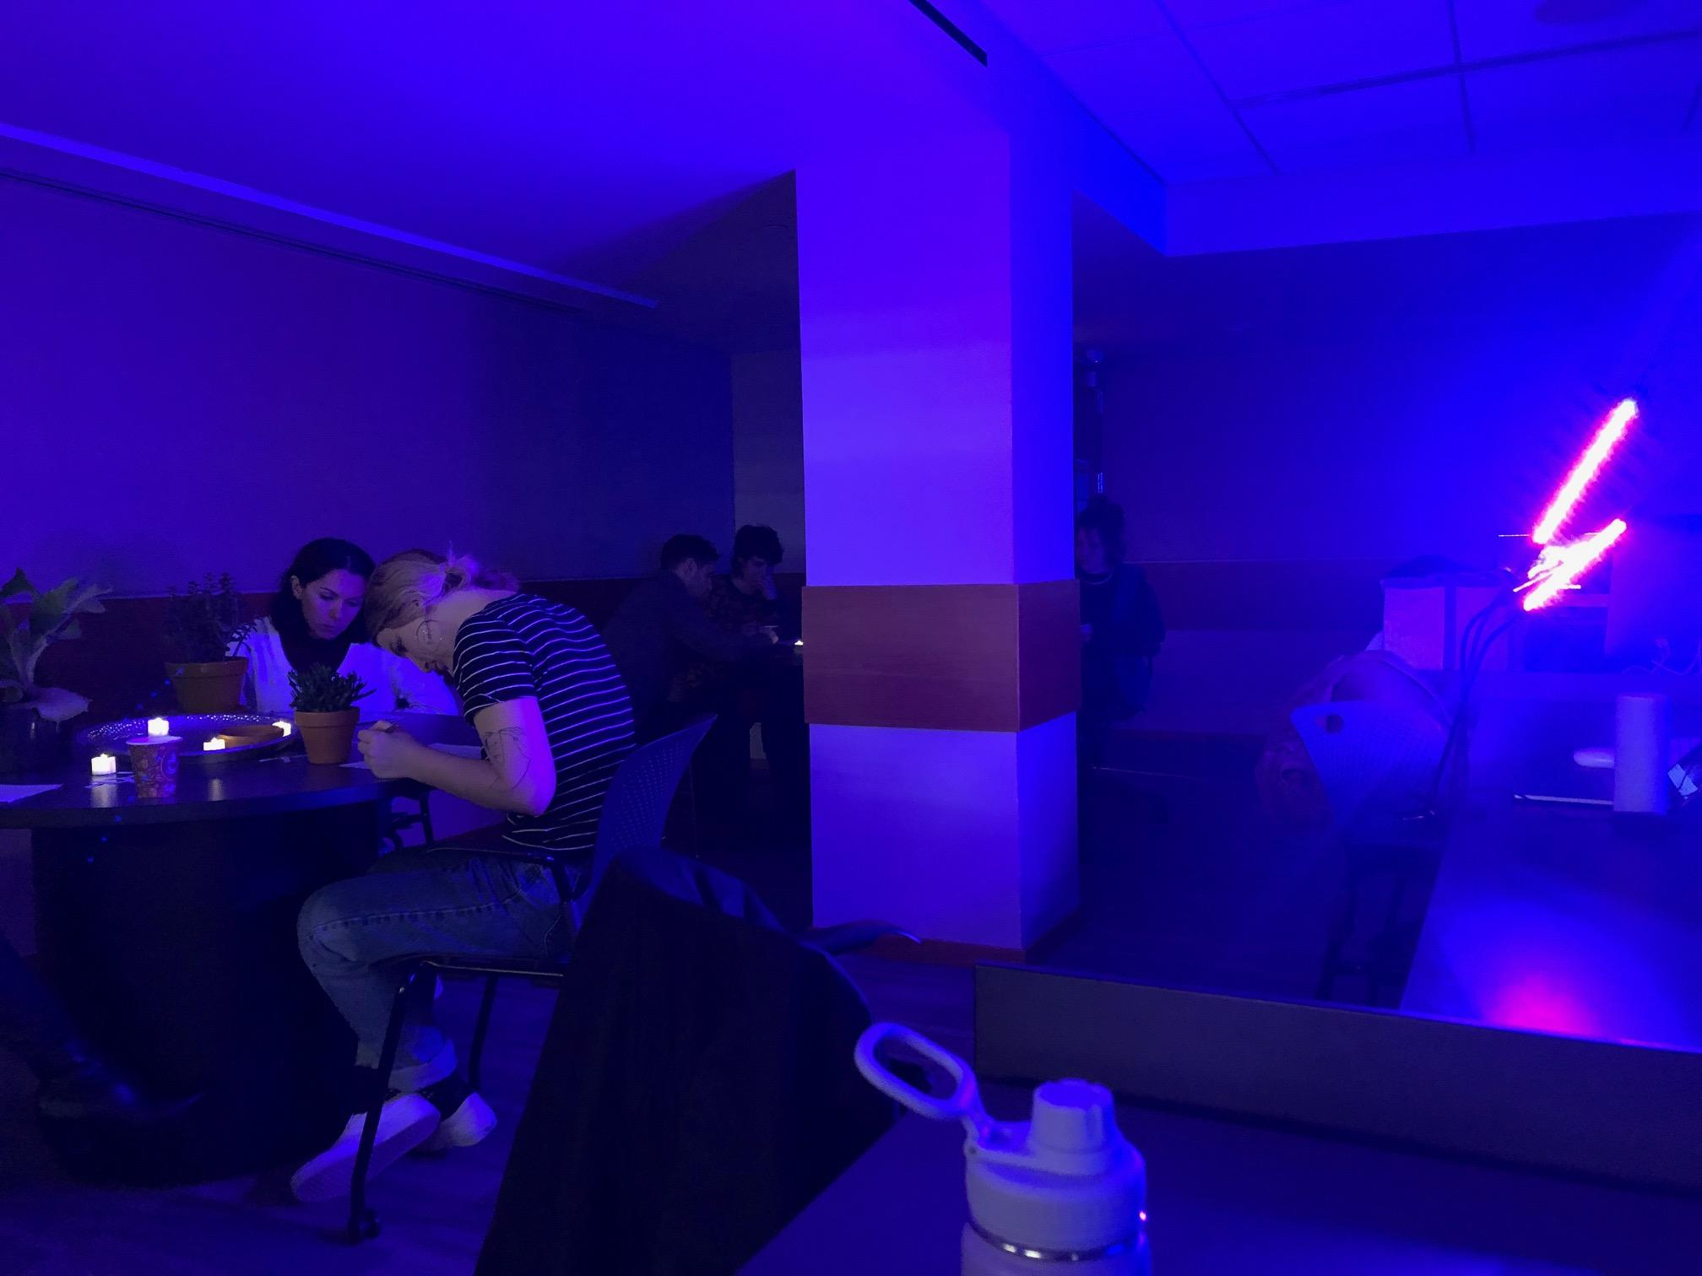
Free Writing at every station

Slide 8
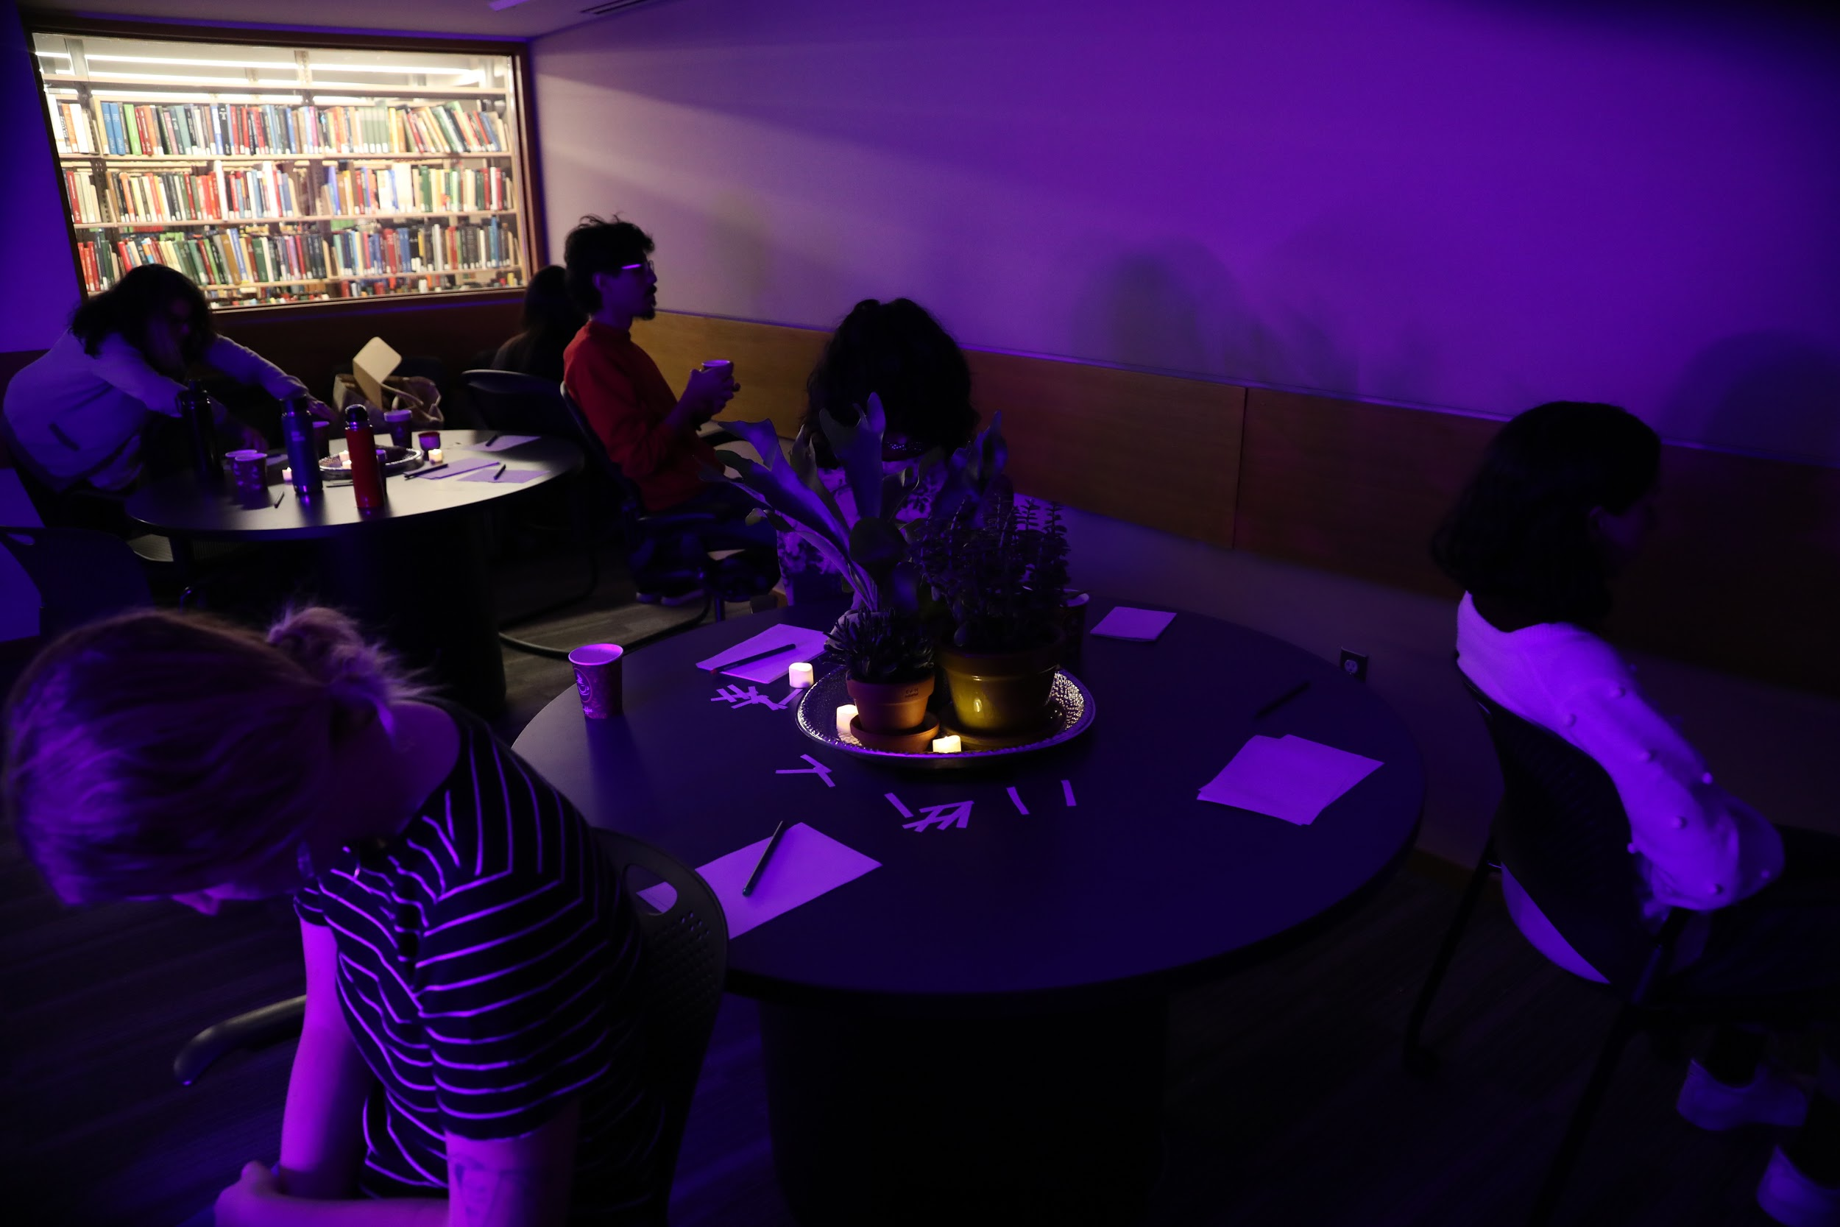
Back Sensing

Slide 9
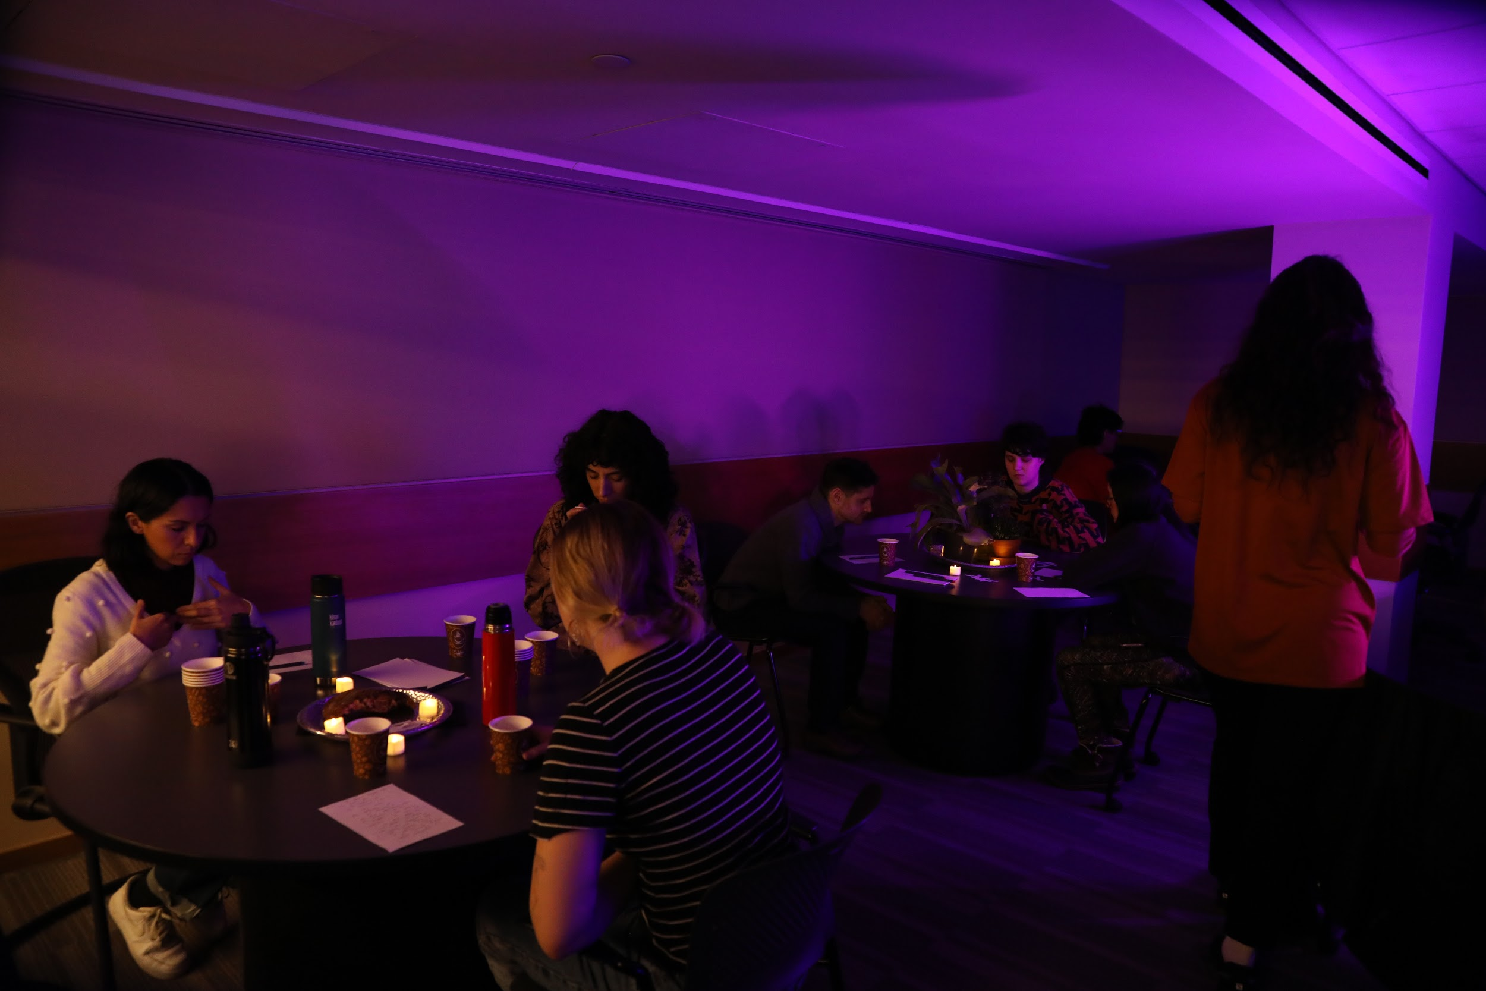
STATIONS
Vocalizing

Slide 10
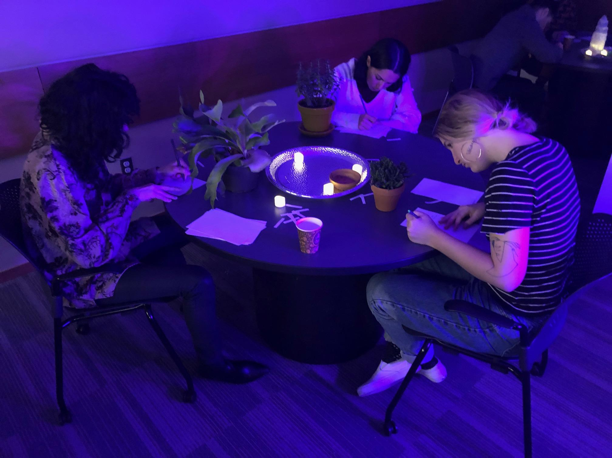
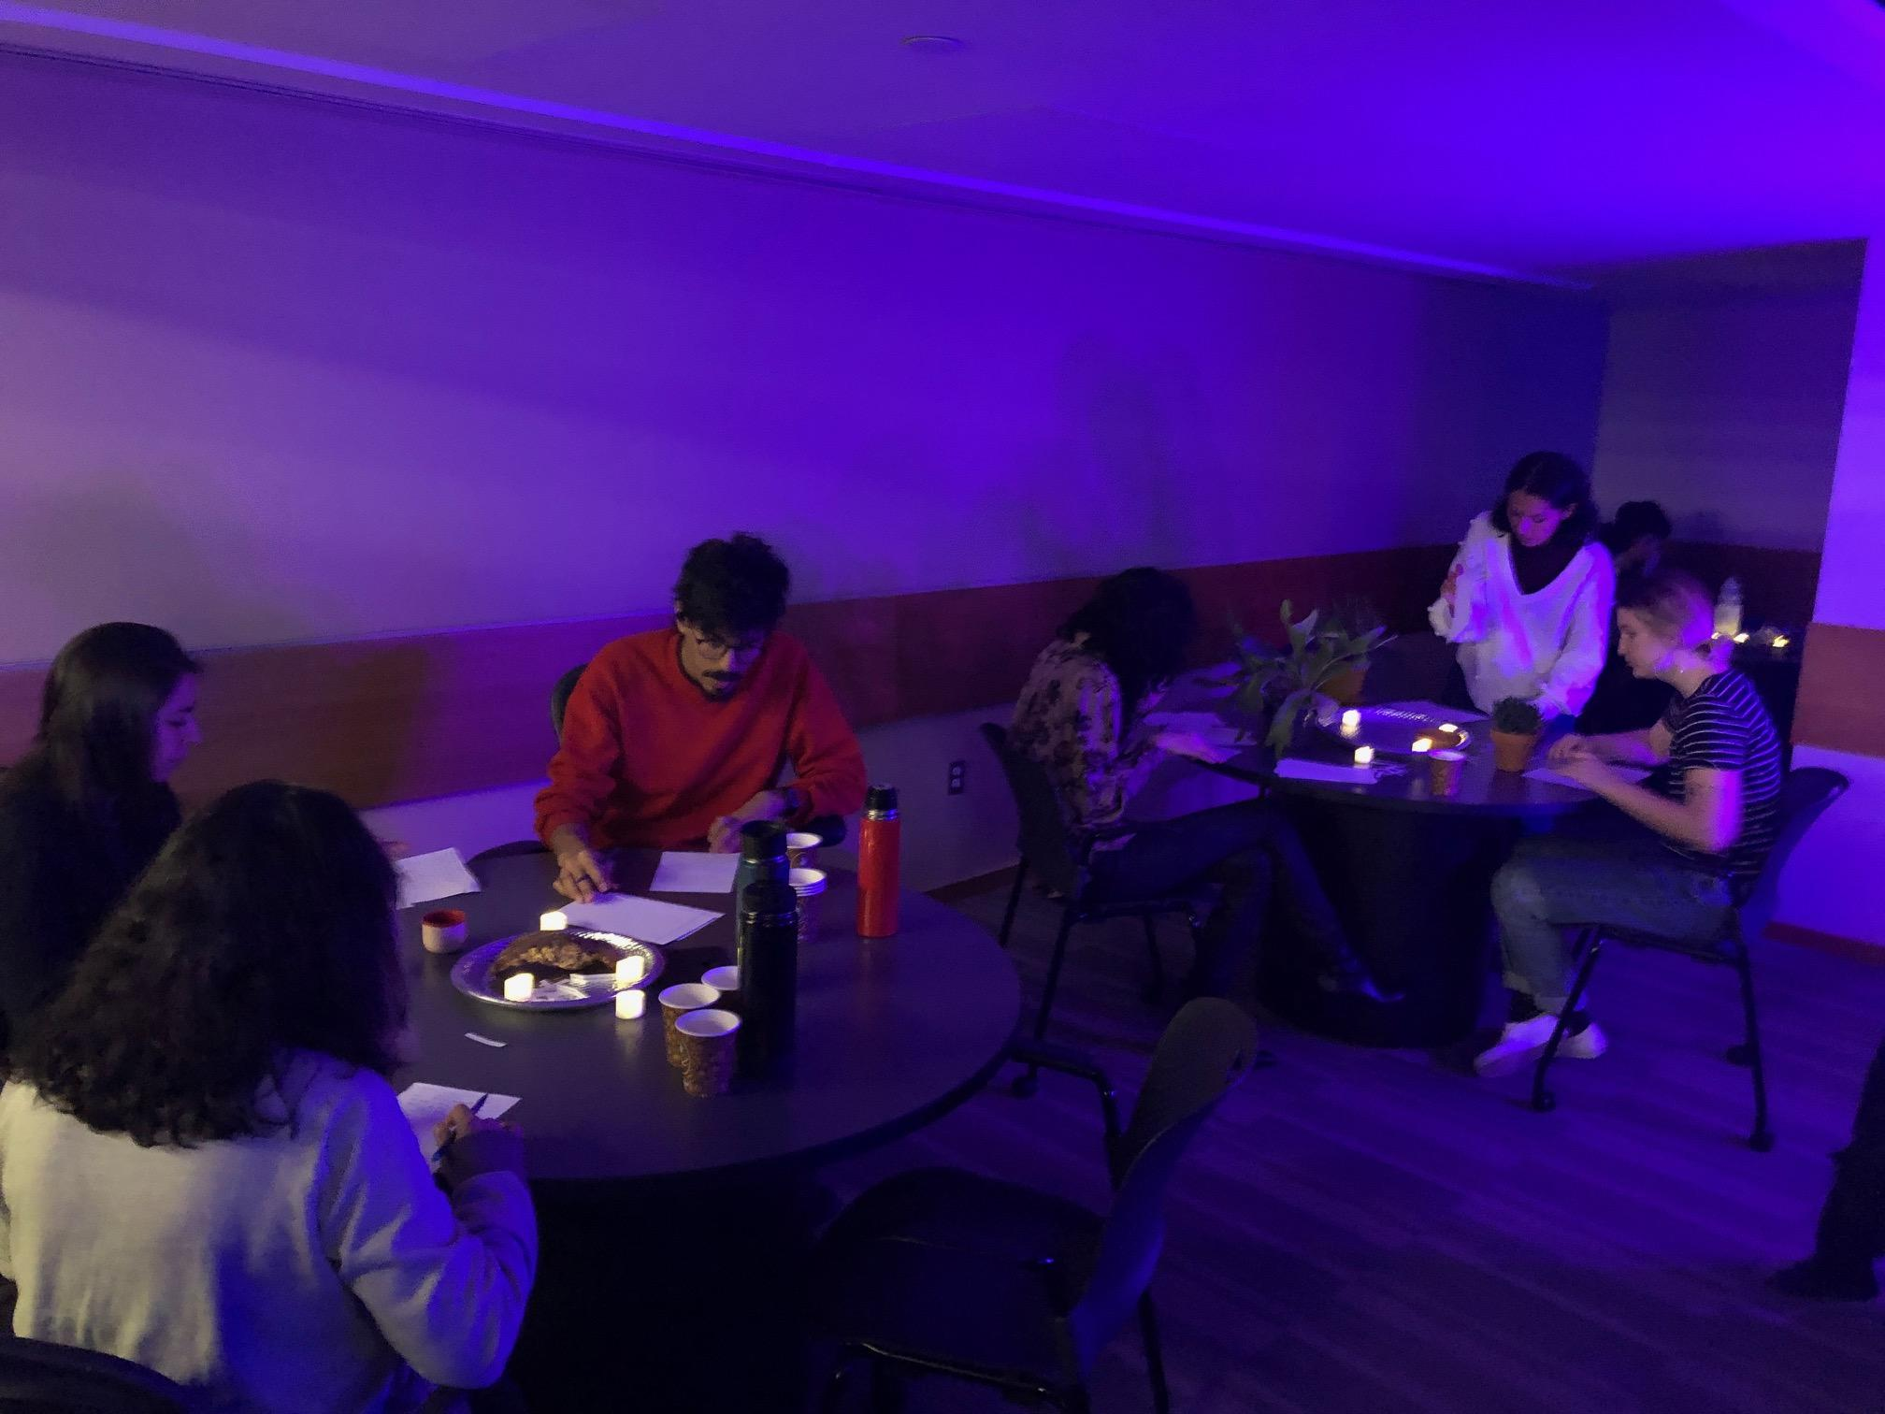
Free Writing

Slide 11
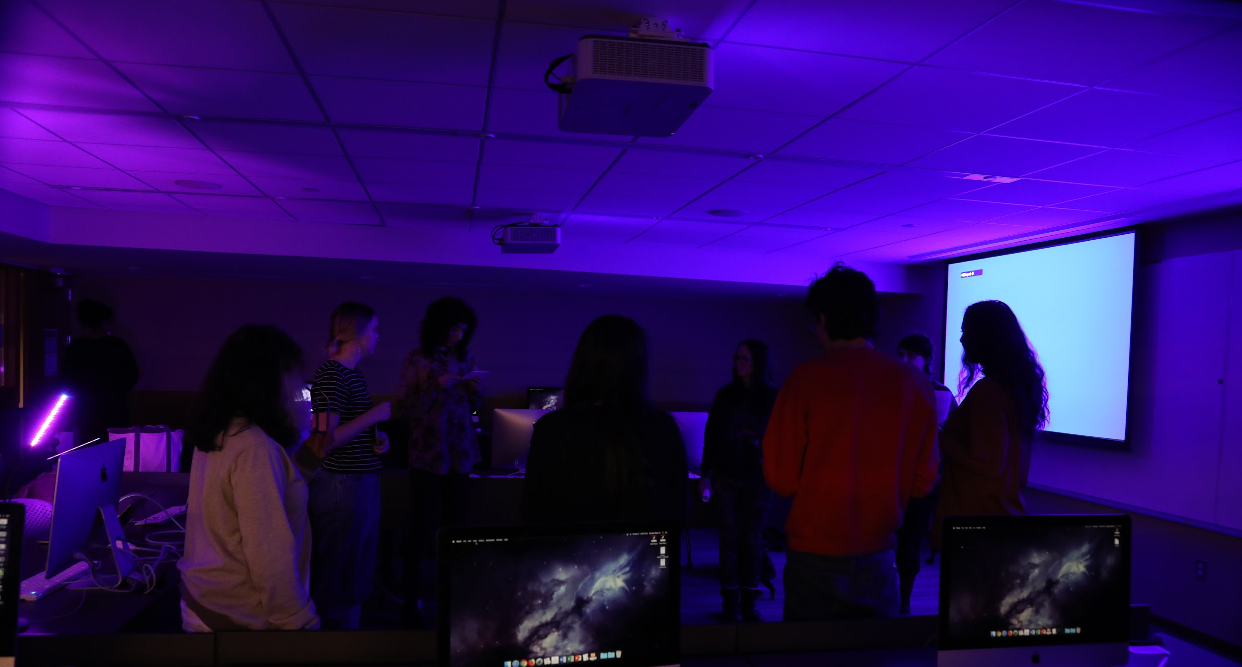
Closing Circle, Writing Share, Last Breathing Exercise

Slide 12
References:
Golden Dome workshops with Eliza Swann & Laura Stinger
CAConrad - Soma(tic) poetry rituals
Iele Paloumpis’ Witchcraft a Corporeal Practice @ Movement Research
Pauline Oliveros - Deep Listening
Ruth Zaporah - Action Theater
Suzanne Cesaire - “homme plant”
Debra Disbrow’s workshop “Presence and Storytelling- Physical and Emotional Impulse” @ Earthdance

Slide 13
Paideumatic: “the tendency of cultures to be shaped--in their major symbolic inspiration and dominant forms--by their own geography, soil and climate.”
OBJECTIVE:
Use somatic exercises to quiet the critical mind and to tap into our bodies so that we can become receptive to receiving information/energy from the nonhuman stations.
Get into a state conducive to nonhuman communion, experimental expression and to have fun.
Perspectivism - Allow the experience and communion to inspire creative storytelling/writing. Writing with nonhumans. Imagining perspectives outside of ourselves.
EXPLORING:
Natureculture
Body Humming
Sensing with different body parts

